Slide 1
A New Day in Education
Brian Adams
EMD 350V M73
“Think Globally, Act Locally”

Slide 2
Introduction
Understanding where we have failed in the lack of leadership in our public schools.
Start a business model for all businesses to follow that involves giving back to public schools.
Make it simple and yet rewarding.

Slide 3
Giving back to Public Schools
College Graduate
Bachelors Marketing
Law Degree J.D./M.B.A.
Career
Education
Career
Domestic Awareness
School Resources
Community Activism
Donations
Books
Schools Supplies
Better prepared students

Slide 4
Problem
Every day in our country about 7,000 students drop out of high school. (Orfield, 2010)*
Half of all college students must take remedial courses after graduating from high school before they can take college level coursework. (Orfield, 2010)*
Public elementary schools and public charter elementary schools averaged 21.2 students and 21.4 students per class, respectively.
*Orfield, C. (2010, 03 09). US Senate Committee on Health, Education, Labor, & Pensions. Retrieved 2010, from http://help.senate.gov/newsroom/press/release/?id=0bebd6b1-56b3-439c-9463-f7e5771cb467&groups=Ranking

Slide 5
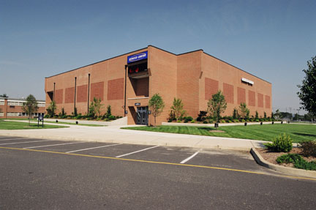
Objective “Think Globally act locally”
Relieve School District of some of the financial burden of providing books to schools.
That financial relief can then go towards teacher salaries, and other financially stress areas of school districts.
Creating confident new leaders.
Students would have a committed to excellence.
Communities see the change they created themselves.

Slide 6
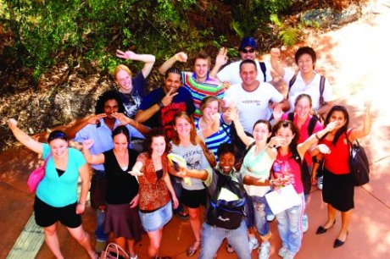
The Vision
Introduce a model similar to TOMS Shoe.
A one for one model.
Using the purchasing power of individuals to benefit the greater good.
Each community buys items for their personal use and then sees the money go towards books or resources for public schools.

Slide 7
Summary Creating Leaders among communities
Creating a Desire to Serve Others
Empowering People to help others
Recognize their shortcomings and helping them teach the younger generations.
This would also help these communities Develop Themselves.

